Slide 1
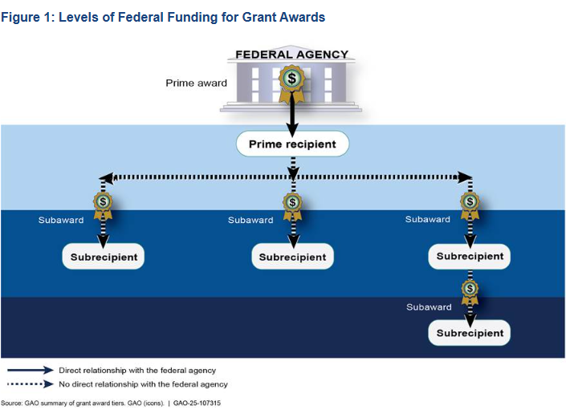
Federal Funding Grant Award Example Pass Throughs: KDE To DOC, DJJ & CHFS
Pass Through TO:
KDE
1. KDE receives Federal Award from US DOE and records as COLLECTED REVENUES Column G, SEFA 02.
2. KDE will show the expenditure in the CASH PASSED THROUGH TO, Column L, for all Departments, listed by ALN.
3. KDE records this Pass Through TO, SEFA 03, Note 4 section, listed numerically by ALN.
Pass Through FROM:
DOC, DJJ & CHFS
Each Department receives funds from KDE records as CASH PASSED THROUGH FROM Column K, SEFA 02.
Each Department will show the expenditures in the Cash Expenditures, Column H, SEFA 02.
Each Department records this Pass Through FROM, SEFA 03, Note 3 section, listed numerically by ALN.
US Dept of Education
Kentucky Dept of Education (Dept 540)
Kentucky Department of Corrections (Dept 527)
Kentucky Department of Juvenile Justice (Dept 523)
CHFS (Cabinet of Health and Family Services (Dept 721)

Slide 2
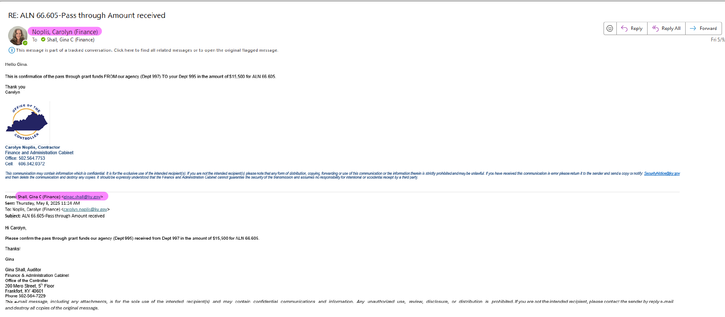
Passthrough communication between Agencies

Slide 3
Determining Federal Award Relationship
and
Reporting Requirements
STEP 1 - Are you the PRIME RECIPIENT¹ of the Federal Award?
Yes → Proceed to Step 2
STEP 2 - Determine the APPROPRIATE RELATIONSHIP CLASSIFICATION
Subrecipient²
No → Reference the "Pass Through Example" and stop
Vendor³
STEP 3 - If Subrecipient²
Is the entity a STATE AGENCY?
Yes → Proceed to Step 4
No →
✅ Report activity in the appropriate Expenditure Column AND the Subrecipient Column
STEP 4 - Is the entity a COMPONENT UNIT⁴?
Yes →
✅ Report activity in the appropriate Expenditure Column AND the Subrecipient Column
No →
✅ Report the expenditures as a Pass Through To the entity
If Vendor³
✅ Report activity in the appropriate Expenditure Column

Slide 4
Relationship Notes and Definitions
Notes:
2 CFR 200.86 - Recipient means a non-Federal entity that receives a Federal award directly from a Federal awarding agency to carry out an activity under a Federal program. The term recipient does not include subrecipients.
2 CFR 200.93 - Subrecipient means a non‐Federal entity that receives a sub award from a pass‐through entity to carry out part of a Federal program; but does not include an individual that is a beneficiary of such program. A subrecipient may also be a recipient of other Federal awards directly from a Federal awarding agency.
2 CFR 200.22 – Vendor an entity that provides goods or services needed to carry out the project or program under a Federal award.
Component Unit Definition and List – In the state of Kentucky, a component unit is a legally separate organization that is included in the financial reporting entity of another governmental unit (the "primary government"). A list of Component Units are shown on the next slide. This information is available to ALL AGENCIES.

Slide 5
Component Unit List ~ pg 1
Entity Name | Dept # | CU Classification | ADDITIONAL NOTES | TML
Kentucky Housing Corporation | 080 | MCU |  | MCU - Major Component Unit
Kentucky Higher Education Student Loan Corporation | 075 | MCU |  | NMCU – Non-Major Component Unit
Kentucky Lottery |  | MCU |  | RET – Retirement Systems Component Unit
Kentucky Public Transportation Infrastructure Authority | 625 | MCU | *Dept # is also used for State Agency submission
University of Kentucky | 455 | MCU
University of Louisville | 460 | MCU
Kentucky Community and Technical College System | 470 | MCU
Kentucky River Authority | 084 | NMCU
Kentucky Higher Education Assistance Authority | 075 | NMCU
Bluegrass State Skills Corporation | 635 | NMCU
Kentucky State Fair Board | 235 | NMCU
Kentucky Center for the Arts Corporation | 552 | NMCU
Kentucky Authority for Educational Television | 545 | NMCU
Kentucky Economic Development Finance Authority | 635 | NMCU
Kentucky Artisan Center | 852 | NMCU
Kentucky Infrastructure Authority | 082 | NMCU | *Dept # is also used for State Agency submission

Slide 6
Component Unit List ~ pg 2
Entity Name | Dept # | CU Classification | ADDITIONAL NOTES | TML
Kentucky Agricultural Finance Corporation | 089 / 035 | NMCU | Confirm with Agency if a CU of the Commonwealth | MCU - Major Component Unit
Kentucky Grain Insurance Corporation | 035 | NMCU | Confirm with Agency if a CU of the Commonwealth | NMCU – Non-Major Component Unit
Louisville Arena Authority |  | NMCU |  | RET – Retirement Systems Component Unit
Kentucky Horse Park Foundation |  | NMCU
Eastern Kentucky University | 430 | NMCU
Western Kentucky University | 465 | NMCU
Morehead State University | 440 | NMCU
Murray State University | 445 | NMCU
Northern Kentucky University | 450 | NMCU
Kentucky State University | 435 | NMCU
Kentucky Council on Postsecondary Education | 415 | NMCU
Kentucky Employees Retirement System | 100 | RET
County Employees Retirement System | 100 | RET
State Police Retirement System | 100 | RET
Kentucky Teachers' Retirement System | 560 | RET
Judicial Retirement Plan | 020 | RET

Slide 7
Component Unit List ~ pg 3
Entity Name | Dept # | CU Classification | ADDITIONAL NOTES | TML
Legislators Retirement Plan | 020 | RET |  | MCU - Major Component Unit
Kentucky Public Employees Deferred Compensation Authority | 790 | RET | *Dept # is also used for State Agency submission | NMCU – Non-Major Component Unit
Kentucky Horse Racing and Gaming Corporation | 374 | NMCU | NEW for FY25 | RET – Retirement Systems Component Unit

